Slide 1
4th Digital Climate Summit 24.06.2024 | 15:00 CET online
Digitalisation
New Opportunities for municipal Climate Action?

Slide 2
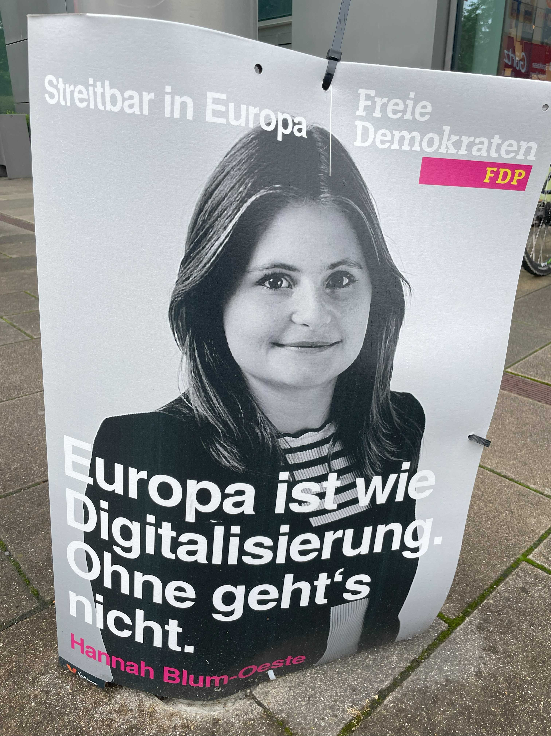
Digitilisation
Is an up-to-date topic
Covers many areas
Is already happening !?
Europe is like digitilisation.
You can‘t do without it.

Slide 3
Project team
Vera Besse &
Sabine Kjaer
Veronika Janak-Nemeth
Carsten Kuhn &
Claudia Schury
Anja Stenglein & Fritz Hofer
Maria Guerrieri &
Cecilia Trenti &
Maurizio Zara

Slide 4
CINAMON:
Spread climate knowledge fast
using digital possibilities
Two E-Learnings for climate managers in municipalities and companies
Climate Action Campaigning
Climate Impact Measurement
Toolbox for Climate Action Tools (100+ tools)
https://cinamon.org/
https://cinamon-elearning.cinamon.info/?lang=en

Slide 5
E-Learning “Climate Action Campaigning”
Fact based climate knowledge
Practical skills to implement climate protection measures
Tips for successful climate communication
https://cinamon-elearning.cinamon.info/

Slide 6
E-Learning “Climate Impact Measurement”
How to count and compare the amount of energy needed and produced in your city or company
How to measure and monitor the CO₂-reductions of climate action measures
How to choose the right tool and how to use it
https://cinamon-elearning.cinamon.info/

Slide 7
Registration https://cinamon-elearning.cinamon.info/login/index.php

Slide 8
Toolbox CAT “Climate Action Tools”
Overview of the different climate tools which are available on the internet
Find the right tool for your needs
https://cinamon.org/

Slide 9
Digital Climate Summits
DCS 1: Successful climate communication
DCS 2: Storytelling in climate change discourse
DCS 3: The power of community
https://www.youtube.com/@cinamonproject7306
https://www.klimabuendnis.at/cinamon-digital-climate-summits/

Slide 10
Agenda Digital Climate Summit 4
15:00 | Welcome and introduction
 | Protecting citizens from heat – using Open Data for Heat Action Plans (Ready4Heat) Martin Hassel, City of Worms, Germany and Axel Veitengruber, Climate Alliance, Germany
 | Digitalisation to support sustainable development Dina El Barjawi, TeamDev, Italy
 | National and local level adaptation databases and information sources in Hungary Olga Müller, National Adaptation Center, HungaroMet, Hungary
 | Digitalise Cycling and learn from Ridership Data Mihai Ghete, bike citizens GmbH, Austria
 | Exchange with the speakers
16:30 | Closing words

Slide 11
Protecting citizens from heat – using Open Data for Heat Action Plans (Ready4Heat) Martin Hassel, City of Worms, Germany and Axel Veitengruber, Climate Alliance, Germany

Slide 12
See PDF
Presentation I- Ready4Heat.pdf

Slide 13
Digitalisation to support sustainable development Dina El Barjawi, TeamDev, Italy

Slide 14
See PDF II
Presentation II_Digital tools for supporting SDGs.pdf

Slide 15
National and local level adaptation databases and information sources in Hungary Olga Müller, National Adaptation Center, HungaroMet, Hungary

Slide 16
See PDF III
Presentation III - National and local level adaptation databases and information sources in Hungary

Slide 17
Digitalise Cycling and learn from Ridership Data Mihai Ghete, bike citizens GmbH, Austria

Slide 18
See PDF IV
Presentation IV - Learning from Ridership data.pdf

Slide 19
Also have look at the Climate Alliance campaign and tools from CITY CYCLING /STADTRADELN https://www.stadtradeln.de
https://www.radar-online.net/home
https://www.radverkehr-in-deutschland.de/
Notes:
CITY CYCLING consists of 3 components:
1. CITY CYCLING the campaign as such
2. The RADar! reporting platform, which we also consider a tool for citizen participation
3. And our RiDE portal, which is an online planning tool based on the routes tracked by hundreds of thousands of cyclists

Slide 20
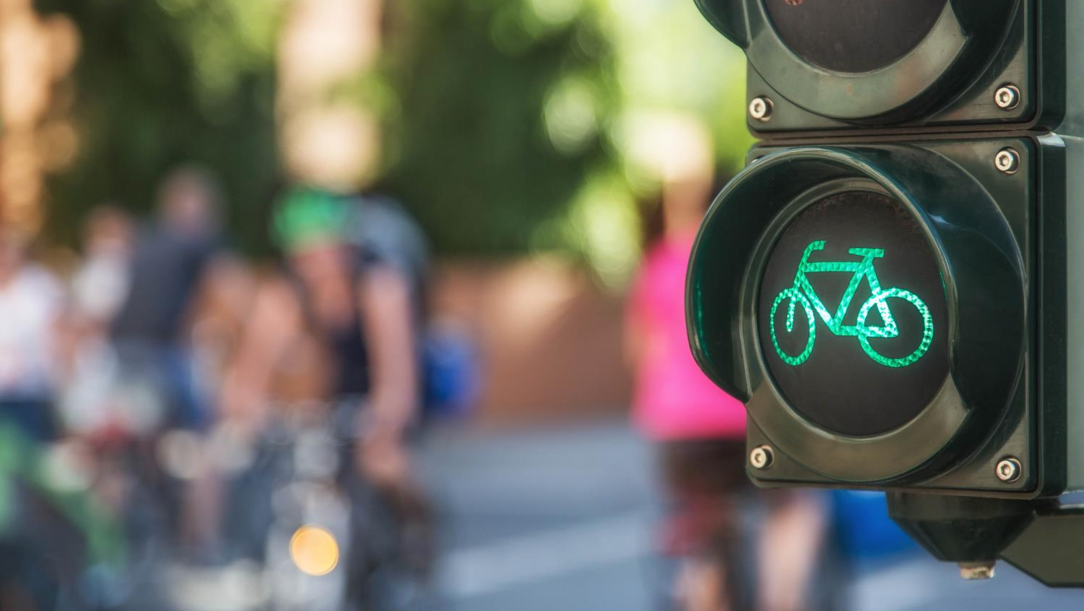
CITY CYCLING, RADar! & Ride
All-in-one:
communication, planning and public participation tool
Notes:
All three components have in common:
They should help us to successfully instigate a mobility transition and get cycling on the political agenda so that we finally are “Cycling the change”.

Slide 21
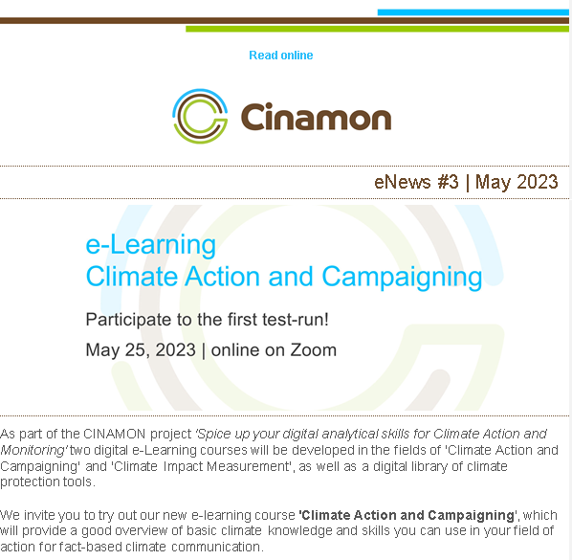
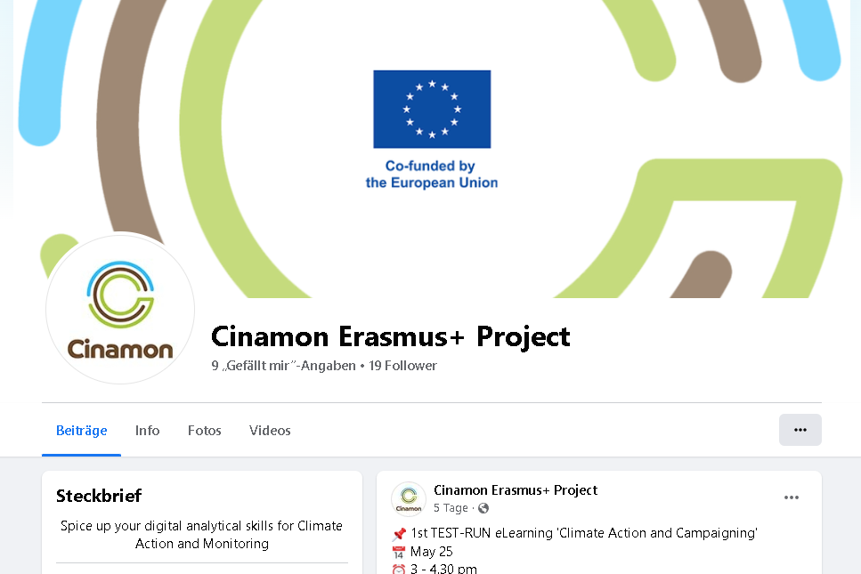
Learn more about CINAMON
https://cinamon.org/
https://www.facebook.com/CinamonProject

Slide 22
Thank you for your attention!
Carsten Kuhn, c.kuhn@klimabuendnis.org
Claudia Schury, c.schury@klimabuendnis.org

